Slide 1

INSTITUTE UIE
DEPARTMENT ACADEMIC UNIT-1
Bachelor of Engineering (Computer Science & Engineering)
Subject Name Introduction Electrical & Electronics Engineering
Subject Code-23ECH-101
Prepared By
Dr. Shikha
Unit-1 Chapter-2
Introduction of Electrical & Electronics Circuit
Lecture No. 1.3.3
BINARY ARITHMETIC
DISCOVER . LEARN . EMPOWER

Slide 2
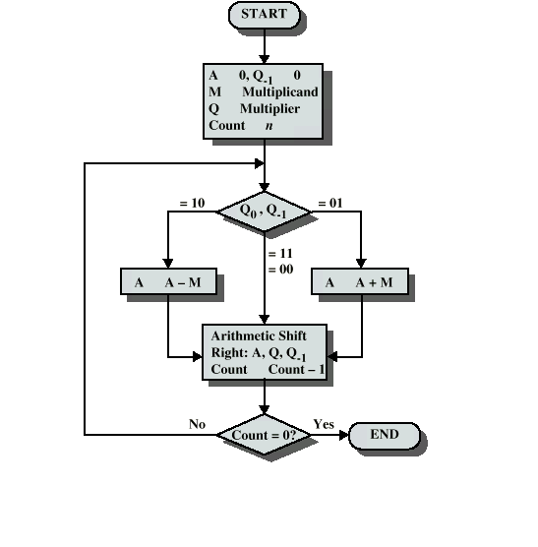
Lecture Objectives
S. No. | Objectives
1 | To make student aware about binary arithmetic operations.
2 | To aware about rules for different binary operations.
3 | To provide knowledge about arithmetic operational techniques by various examples.

Slide 3
Course Objectives
S. No. | Objectives
1 | Understand Electrical & Electronics Engineering Fundamentals
2 | To prepare students to perform the analysis and design of various Electrical & digital electronic circuits.

Slide 4
Course Outcomes
CO Number | Title | Level
CO1 | To identify the different types of electrical elements and the basic op-amp circuit elements and to illustrate the various types of motors, transducers. | Remember
CO2 | To understand basic principles of transformers, transducers, op-amps, DC and AC motors and to compare the different methods for analysing electrical and magnetic circuits. | Understand
CO3 | To derive the relationships between parameters in electric and magnetic circuits and motors and to determine specifications of op-amps. | Analyze
CO4 | To solve the basic problems related to electric circuits, magnetic circuits and motors and to assess the characteristics of different configurations of op-amps. | Evaluate
CO5 | To design the different applications of transducers, motors as well as the op-amps like adders, subtractor and comparators. | Create

Slide 5
BINARY ARITHMATIC
Course Objectives
To acquire basic knowledge of digital logic levels and applications to understand digital electronics circuit. To prepare students to perform the analysis and design of various digital electronics circuits To make student understand basic difference between analog and digital electronics
Course Outcome
CO Number | Title | Level
CO1 | Merits of digital systems , various number systems and their applications. | Remember and understanding
CO2 | Combinational and sequential digital designing and solution to basic circuits. | Applying and Analyzing
CO3 | Designing of sequential circuits and introduction to memory design logics. | Evaluating and creating
Figure 1.1 Binary Aritmatic [1]

Slide 6
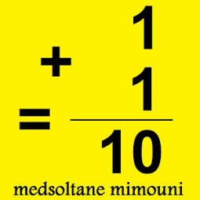
BINARY ARITMATIC
Addition
Subtraction
Multiplication
Division
Fig1.2. Binary Addition[2]

Slide 7
BINARY ADDITION
Rules of Binary Addition
A+B | Sum | Carry
0+0 | 0 | 0
0+1 | 1 | 0
1+0 | 1 | 0
1+1 | 0 | 1
Examples :-
110101
+ 111101
1110010
110101
- 101101
001000

Slide 8
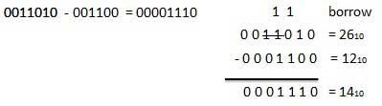
Rules of Binary Subtraction
A-B | Diff | Borrow
0-0 | 0 | 0
0-1 | 1 | 1
1-0 | 1 | 0
1-1 | 0 | 0
110101
- 101101
001000

Slide 9
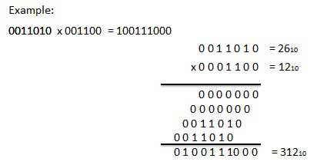
BINARY MULTIPLICATION
Multiplication in binary is exactly as it is in decimal, i.e. multiply numbers right to left and multiply each digit of one number to every digit of the other number, them sum them up. The 3 basic binary multiplication rules are also similar to decimal.
1 * 1 = 1
1 * 0 = 0 * 1 = 0
0 * 0 = 0
Also, remember that for every left shift of digit of the multiplier, an extra zero needs to be appended to the product. This is similar to the decimal system as well.
Case | A*B | RESULT
1 | 0*0 | 0
2 | 0*1 | 0
3 | 1*0 | 0
4 | 1*1 | 1
Fig1.1Binary multiplication[1]

Slide 10
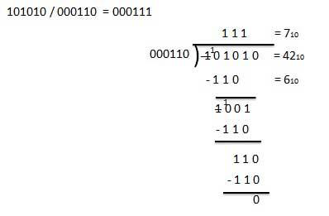
BINARY DIVISION
Fig1.2 binary division[2]

Slide 11
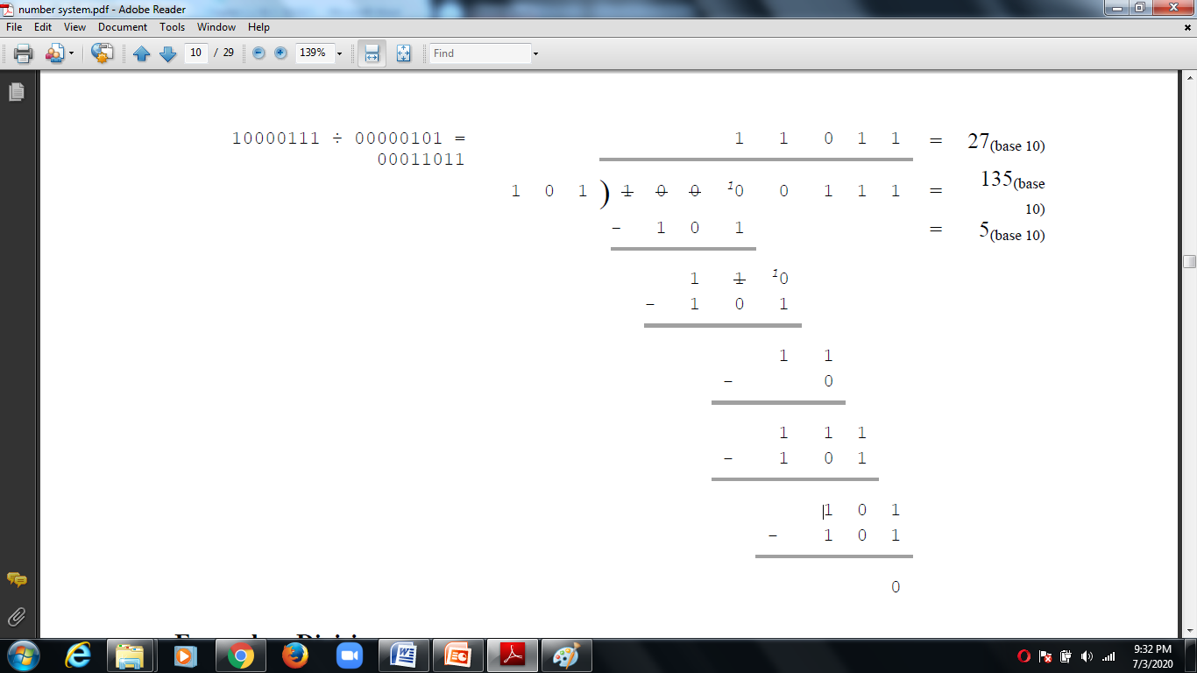
Binary Division
Fig1.3 binary division[2]

Slide 12
APPLICATIONS
Computers
Calculators
ATM
Mobile Phone
Integrated Circuits and so on......

Slide 13
REFERENCES
https://www.google.com/search?q=binary+multiplication+examples&oq=binary+multiplication+examples&aqs=chrome..69i57j0l7.10302j0j4&sourceid=chrome&ie=UTF-8
http://www.ipsgwalior.org/download/number%20system.pdf
https://www.google.com/search?q=decimal+to+binary&source=lnms&tbm=isch&sa=X&ved=0ahUKEwi6nMvW5uHiAhVBXSsKHUgGC60Q_AUIECgB&biw=1517&bih=730#imgrc=cl-xz1ixddfv9M
www.cse.yorku.ca/~mack/1011/01.NumberSystems.ppt
https://www.google.com/search?q=binary+to+grey+conversion&source=lnms&tbm=isch&sa=X&ved=0ahUKEwjD6vrQi-PiAhVMSX0KHftLDngQ_AUIECgB&biw=1366&bih=657#imgrc=bkt5qsZlpTZ1sM
http://www.geeksforgeeks.org/digital-electronics-logic-design-tutorials/
https://www.google.com/search?q=binary+to+grey+conversion&source=lnms&tbm=isch&sa=X&ved=0ahUKEwjD6vrQi-PiAhVMSX0KHftLDngQ_AUIECgB&biw=1366&bih=657#imgrc=bkt5qsZlpTZ1sM
http://www.ni.com/example/14493/en/
https://www.tutorialspoint.com/digital_electronics/index.asp
https://www.tutorialspoint.com/computer_logical_organization/complement_arithmetic.htm
Floyd & Jain, Digital Fundamentals, Pearson.
Mano,Morris, Digital Design, Prentice Hall of India.
Fletcher, An Engg. Approach to digital design, Prentice Hall of India.

Slide 14


